Slide 1
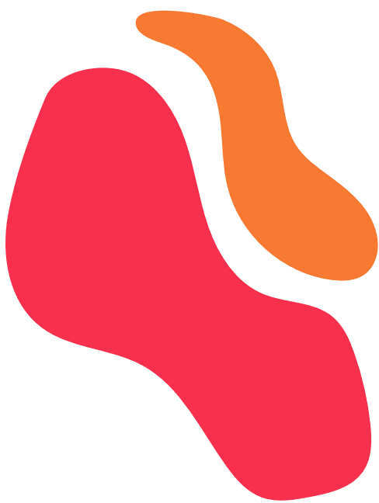


Insights into Smart Device User Behaviour
Konstantinos Valourdos
07/07/2024
1
Bellabeat Analysis

Slide 2
Agenda
1.
2.
3.
4.
Smart device business task
Analysis of
non-Bellabeat devices
Insights to apply
Conclusions
&
Suggestions
2

Slide 3




Business Task
Non-Bellabeat Devices
Analyse & Identify Relevant Data
Drive Marketing decisions
3

Slide 4
User Engagement
Activity & Calorie tracking are most used
Metabolic Equivalents not far behind (MET)
Sleep has moderate popularity
Dedicated users even for lower popularity
4
Notes:
There are users for Weight and BMI that logged their weight everyday for the entirety of the month.
Just like weight there are all other tracking functionalities have the same trend. Even if there are not a lot of users there is a small niche of VERY DEDICATED users.

Slide 5

Which feature are worth investing in?
Activity
Calorie
Popular
Niche
MET
Sleep
Weight
Heart rate
5

Slide 6
User Activity Ranking
The activity level of users was determined by the following variables :
Activity Time [Emphasising Moderate or above activity levels]
Steps
Walking/Running Distance
Calories Burned
6
Notes:
-The activity levels of the users is tracked
-to help forming a more specific picture of what the userbase is like and
-as a result the functions they would like on their device

Slide 7
User Activity Ranking
Users vary in their activity level
Most are average activity or below
What do these types of users engage with?
What users does the Leaf cater to?
7

Slide 8
Trends and Relationships
Analysing the correlation between activity and sleep to determine the potential benefits of educating users on sleep tracking, thereby enhancing the value of including the sleep tracking function in the Leaf product.
No significant correlation.
8
Notes:
Read slide…

Slide 9

Conclusions
Base decisions on the identity of Leaf
Most used tracking features are
Activity & Calorie
The majority of the userbase is average or below
Some dedicated users belong to the minority of the userbase
9

Slide 10
Suggestions
Concentrate on the Activity and Calorie tracking
Keep sleep tracking functionalities basic
Omit heart rate, weight, and MET tracking due to low usage and no display.
Heart rate tracking is part of Calorie tracking so can be kept to a minimum
9
Notes:
Activitie and Calorie tracking are the most commonly used and the reason why most people buy a fitness tracker.
Sleep tracking will not be one of the selling points of the device since many people will probably remove the bracelet or necklace in their sleep.
In addition sleep tracking is not at used as other features.
Reason to keep other functionalities out.
-No display on the device this makes BMI and Weight even less intuitive with this device and should not be included to save project resources.
-MET is highly specific for more dedicated users that are very active and since the users are more casual
-Heart rate is also kept to a minimum. It only works when the Leaf is worn on the wrist, and needs to be checked on the phone.
.

Slide 11
Limitations and Additional Data
To target our audience and demographic we need:
Larger dataset
Data from Bellabeat devices
Satisfaction surveys
9
Notes:
Activitie and Calorie tracking are the most commonly used and the reason why most people buy a fitness tracker.
Sleep tracking will not be one of the selling points of the device since many people will probably remove the bracelet or necklace in their sleep.
In addition sleep tracking is not at used as other features.
Reason to keep other functionalities out.
-No display on the device this makes BMI and Weight even less intuitive with this device and should not be included to save project resources.
-MET is highly specific for more dedicated users that are very active and since the users are more casual
-Heart rate is also kept to a minimum. It only works when the Leaf is worn on the wrist, and needs to be checked on the phone.
.

Slide 12
Next Steps
Product Development
Implement recommended features
Further Research
Increase sample size - Collect first-party data
Marketing Strategy
Develop campains around the suggested features
User Feedback
Collect user feedback to:
Refine the product - Streamline future projects
9
Notes:
Activitie and Calorie tracking are the most commonly used and the reason why most people buy a fitness tracker.
Sleep tracking will not be one of the selling points of the device since many people will probably remove the bracelet or necklace in their sleep.
In addition sleep tracking is not at used as other features.
Reason to keep other functionalities out.
-No display on the device this makes BMI and Weight even less intuitive with this device and should not be included to save project resources.
-MET is highly specific for more dedicated users that are very active and since the users are more casual
-Heart rate is also kept to a minimum. It only works when the Leaf is worn on the wrist, and needs to be checked on the phone.
.

Slide 13
Thank you for your time!
Konstantinos Valourdos
1

